Slide 1
Analysing your data
PsychoPy saves several data files for different uses:
A Microsoft Excel (spreadsheet) file that you can use for most analyses
A ‘psydat’ file (or one for each loop in your experiment). You can’t read this but it’s good for us to analyse with scripts
A ‘log’ file that provides lots of detail but not easy to analyse (open in excel to have a look)
To find these
Go to the folder where you saved the experiment
There will be a new folder inside that (next to the psyexp file) called “data”
Inside the data folder will be a Microsoft Excel file named by your username and the date
Copy the xxxxxxx_trials.psydat file (for our batch analysis) to; class_share/C81MPR/lab1_stroop

Slide 2
Using Excel
Having saved that copy to the class_share folder go back to the Excel (xxxxx.xlsx) file and open it (e.g. with double-click)
That opens Microsoft Excel, a spreadsheet application, which allows you to work with data in a large table format to perform simple analyses
To analyse your data today you could simply use a calculator but, in the long run, learning to use Excel will save you a lot of time!

Slide 3

Worksheets
In the Excel file that was saved by PsychoPy you’ll find two worksheets (see the tab at the bottom), one for the practice trials, one for the main trials
Select the worksheet for the main trials

Slide 4
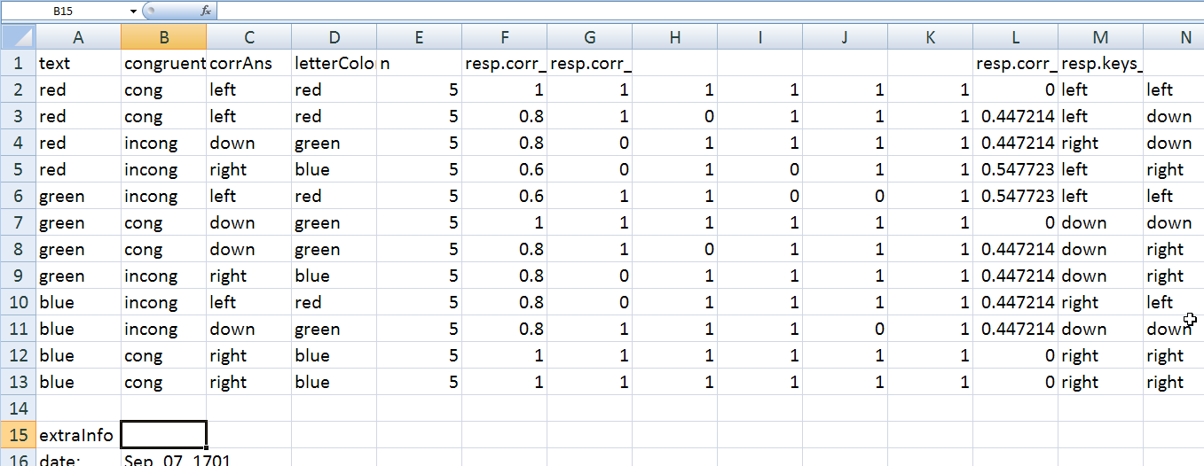
PsychoPy data files
In the data files each row represents a different trial type. We have 12 trial types here.
The columns give information about the stimuli and the responses. The top row tells us what is in each column
Notes:
NB these screenshots come from Excel 2007 (Windows)
Under Mac and other versions of Excel the instructions differ slightly

Slide 5
PsychoPy data files
Some of the information is about the parameters that we used to control the stimuli

Slide 6
PsychoPy data files
This column tells us how many trials were run of each type.

Slide 7
PsychoPy data files
This row is too narrow for the title to be fully visible, but if you click on that cell it reads, resp.corr_mean. This row gives us the fraction of correct answers

Slide 8
PsychoPy data files
The next header says resp.corr_raw and gives 5x12 values (5 repeats of 12 conditions). A zero means the subject got the answer wrong that trial, a one means they got it right.

Slide 9
Analysing the Stroop data
For the Stroop task we want to know about reaction times in the different conditions
If you look way over to the right you’ll find a column called resp.rt_mean (and resp.rt_raw) which show the reaction times
Let’s copy the congruence and the resp.rt_mean columns to be closer together

Slide 10
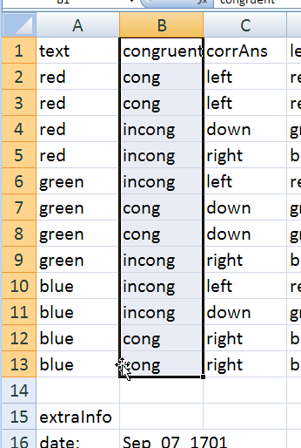
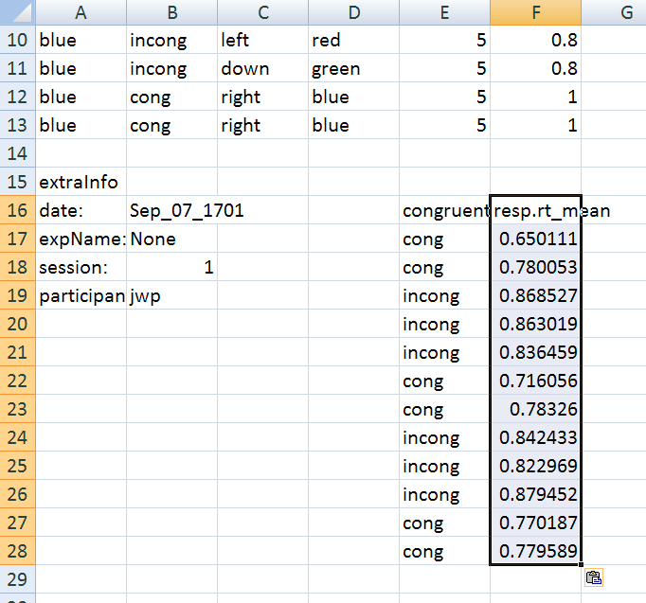
Copying a group of cells
Select the cells specifying the congruence, including the header (click on the top cell and then press Shift and click on the bottom cell that you want)
Now go to >Edit>Copy or press Ctrl-C
Go to cell E16 and paste
Now also copy the cells that give the rt_mean next to these ones to get this

Slide 11
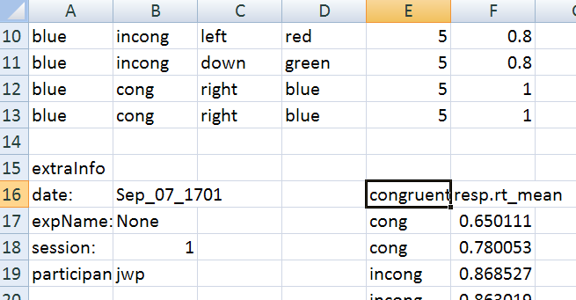
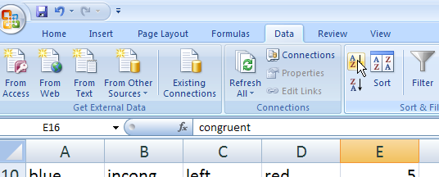
Sorting cells
Select the cell ‘congruent’ (E16)
Find the Sort button in the toolbar (you may need to select the Data tab first):
Your data should now be sorted by congruency
Caution: whenever you sort data make sure you can see which data have been sorted – if you have a subset of data selected then only that gets included in the sort and your rows won’t correspond up any more!!

Slide 12
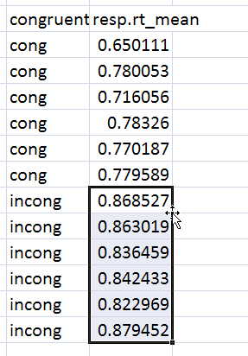
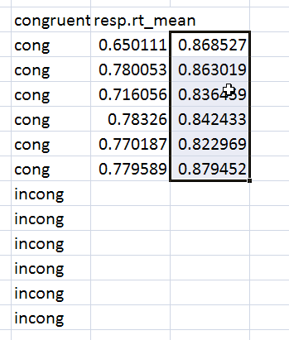
Moving cells
To move the incongruent RTs into a different column:
Select the RTs for that condition
hover your mouse over the edge of the selection so it changes to this symbol
when you see the ‘move’ symbol you can drag that cell up and to the right to align with congruent
(if it goes wrong just press Ctrl-Z to undo)

Slide 13
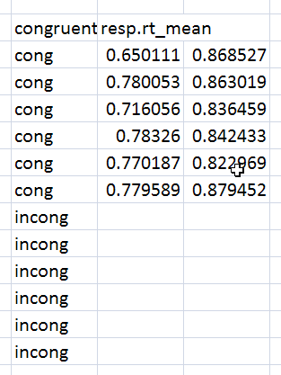
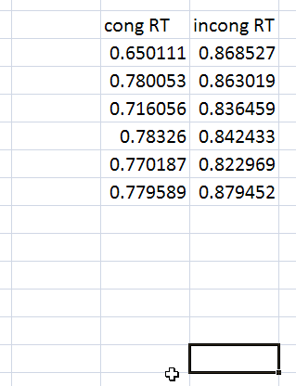
Relabel your columns
(You’d be amazed how easy it is to lose track of your workings if the labels aren’t right)

Slide 14
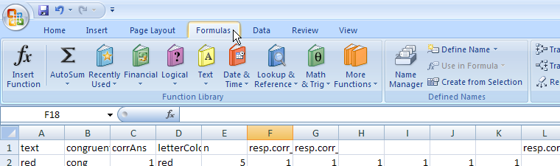
Taking the average
Calculate the mean of the congruent RTs (Excel calls this the average)
Click on cell F24
Insert the ‘average’ formula:
On Windows, select the ‘Formulas’ tab, then press the Insert Function button
Notes:
On a Mac go to the menu >Insert>Function

Slide 15
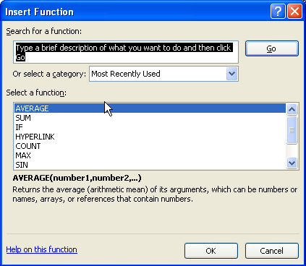
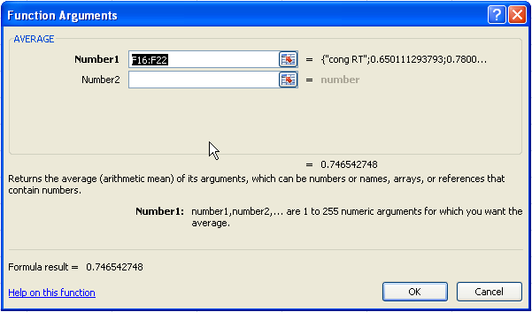
Taking the average
A dialog box appears where you need to double-click the function you want (AVERAGE)
This brings up a second dialog, where you can select (or type) the cells you want to take an average of
We want the range F16:F22
(Excel may have guessed this already)

Slide 16
Excel makes life easy
When you press OK, the mean should have been inserted in the cell
You could have done that on a calculator, but this is quicker, especially if you have lots of values
Even better though, see what happens when you copy that cell (F24) and paste it into cell (G24)
Excel calculates that average as well!

Slide 17
Excel relative references
How did that work?!
When you entered the range of cells for the first average, you actually entered a ‘relative reference’:
Excel interprets the range not as F16:22 but as “the 6 cells above me, one cell away”
When that is copied and pasted somewhere new it looks at the same relative location for the formula
If we had typed $F$16:$F$22 we would have got fixed locations (absolute references) for those cells instead

Slide 18
Other useful Excel functions
Excel allows you to calculate lots of different things in a similar way, using insert function:
COUNT (the number of cells containing a value)
SUM
MODE
MEDIAN
STDEV (std. dev. Using N-1 normalisation)
STDEVP (std. dev. Using N normalisation)
CORREL (coefficient of correlation)
…
Notes:
The difference in the two STDEV functions will be more clear when you cover measures of spread in statistics

Slide 19
Now…
Hopefully you can now see the average response time across all your congruent and incongruent trials.
Was there a difference between them?

